Slide 1

Dr Mahalingam College of Engineering & Technology
Department of Computer Science and Engineering 19CSPN6601- Innovative and Creative Project
Final Review
Title: Website for House Price Prediction in Bangalore
Team Number: 22BCSB003
Team Member(s): 19BCS006- REENA SAJAD HYDER
19BCS078- SHYAM D
19BCS080- DHARINEESH B
Faculty Supervisor: Dr. M. L. Valarmathi, Professor/CSE
Date:22.06.2022

Slide 2
Contents
Domain Introduction
Problem Description
Objective
Literature Survey (12)
Design (Block Diagram)
Module Description
UI Design
Hardware /Software Requirements
Online course details/Progress
Certificates for contest participation (Project Display)

Slide 3
Domain(Data Science) Introduction:
Data science can be defined as the study of data, where it comes from, what it represents, and the ways by which it can be transformed into valuable inputs and resources to create business and IT strategies.
There are five main stages in the data science life cycle. They are data collection, data cleaning, exploratory data analysis (EDA), model building and production.

Slide 4
Problem Description:
House Price prediction is very important for Real Estate efficiency. Earlier, house prices were determined by calculating the acquiring and selling price in a locality. With the House Price prediction model, the information gap has been filled, hence improving Real Estate efficiency.

Slide 5
Problem Description:
The project aims to predict the price of houses based on area in sq. feet, number of bedrooms(bhk), bath(number of bathrooms) and location(as given by the user).
Existing systems don’t have the ability to predict the prices but rather to search for properties or houses based on user specification.

Slide 6
Objective:
To build a prediction model using linear regression machine learning model.
To write a python flask server that uses the saved model to serve http requests.
To build a website using html, CSS and JavaScript for the User Interface (UI).

Slide 7
Literature Survey:
House Price Index (HPI) is commonly used to estimate the changes in housing price.
To explore various impacts of features on prediction methods, this paper will apply both traditional and advanced machine learning approaches to investigate the difference among several advanced models.
This paper will also comprehensively validate multiple techniques in model implementation on regression and provide an optimistic result for housing price prediction.
[1] Quang Truong, Minh Nguyen, Hy Dang, Bo Mei, Housing Price Prediction via Improved Machine Learning Techniques, Procedia Computer Science, Volume 174,2020, Pages 433-442, ISSN 1877-0509, https://doi.org/10.1016/j.procs.2020.06.111.

Slide 8
Literature Survey:
This study utilizes machine learning algorithms as a research method that develops housing price prediction models.
We create a housing cost prediction model in view of machine learning algorithm models, for example, XGBoost, lasso regression and neural system and look at their order precision execution.
Those examinations exhibit that lasso regression algorithm, in view of accuracy, reliably outperforms alternate models in the execution of housing cost prediction.
[2] Priya, G.. (2021). House Price Prediction using Machine Learning Techniques. International Journal for Research in Applied Science and Engineering Technology. 9. 3645-3650. 10.22214/ijraset.2021.35831.

Slide 9
Literature Survey:
The objective of this study is to empirically compare the predictive power of the hedonic model with an artificial neural network model on house price prediction.
A sample of 200 houses in Christchurch, New Zealand is randomly selected from the Harcourt website.
Empirical results support the potential of artificial neural network on house price prediction, although previous studies have commented on its black box nature and achieved different conclusions.
[3] Limsombunchai, Visit & Gan, Christopher & Lee, Minsoo. (2004). House Price Prediction: Hedonic Price Model vs. Artificial Neural Network. American Journal of Applied Sciences. 1. 10.3844/ajassp.2004.193.201.

Slide 10
Literature Survey:
This research aims to predict house prices based on NJOP houses in Malang city with regression analysis and particle swarm optimization (PSO).
PSO is used for selection of affect variables and regression analysis is used to determine the optimal coefficient in prediction.
The result from this research proved combination regression and PSO is suitable and get the minimum prediction error obtained which is IDR 14.186
[4] Adyan Nur Alfiyatin, Ruth Ema Febrita, Hilman Taufiq and Wayan Firdaus Mahmudy, “Modeling House Price Prediction using Regression Analysis and Particle Swarm Optimization Case Study : Malang, East Java, Indonesia” International Journal of Advanced Computer Science and Applications(IJACSA), 8(10), 2017.

Slide 11
Literature Survey:
The literature attempts to derive useful knowledge from historical data of property markets.
Machine learning techniques are applied to analyse historical property transactions in Australia to discover useful models for house buyer and sellers.
Revealed is the high discrepancy between house prices in the most expensive and most affordable suburbs in the city of Melbourne.
[5]T. D. Phan, "Housing Price Prediction Using Machine Learning Algorithms: The Case of Melbourne City, Australia," 2018 International Conference on Machine Learning and Data Engineering (iCMLDE), 2018, pp. 35-42, doi: 10.1109/iCMLDE.2018.00017.

Slide 12
Literature Survey:
This work considers the issue of changing house price as a classification problem and applies machine learning techniques to predict whether house prices will rise or fall.
This work applies various feature selection techniques such as variance influence factor, Information value, principle component analysis and data transformation techniques such as outlier and missing value treatment as well as box-cox transformation techniques.
[6]D. Banerjee and S. Dutta, "Predicting the housing price direction using machine learning techniques," 2017 IEEE International Conference on Power, Control, Signals and Instrumentation Engineering (ICPCSI), 2017, pp. 2998-3000, doi: 10.1109/ICPCSI.2017.8392275.

Slide 13
Literature Survey:
This study proposes a performance comparison between machine learning regression algorithms and Artificial Neural Network (ANN).
The regression algorithms used in this study are Multiple linear, Least Absolute Selection Operator (Lasso), Ridge, Random Forest.
There are two datasets used in this study, called public and local which contain house prices from Ames, Iowa, United States and Malmö, Sweden.
[7]N. Aghi and A. Abdulal, ‘House Price Prediction’, Dissertation, 2020.

Slide 14
Literature Survey:
The objective of the paper is the prediction of the market value of a real estate property.
This system helps find a starting price for a property based on the geographical variables.
By breaking down past market patterns and value ranges and coming advancements, future costs will be anticipated.
This examination means to predict house prices in Mumbai city with Decision tree regressor.
[8]Kuvalekar, Alisha and Manchewar, Shivani and Mahadik, Sidhika and Jawale, Shila, House Price Forecasting Using Machine Learning (April 8, 2020). Proceedings of the 3rd International Conference on Advances in Science & Technology (ICAST) 2020

Slide 15
Literature Survey:
This paper presents a system that works on a set of data containing house prices of places in Mumbai along with the major parameters affecting the price such as area, location, swimming pool, etc. obtained from open web source Kaggle Inc.
It predicts the resale price under the parameters.
The model implemented incorporates ensemble learning (weighted average of Decision Tree, Linear Regression, and K-Nearest Neighbour)
[9]Sushant Kulkarni,Shefin Shajit,Akshay Mohite,Dr. Swati Sinha, "HOUSEPRICEPREDICTIONUSINGENSEMBLELEARNING", International Journal of Creative Research Thoughts (IJCRT), ISSN:2320-2882, Volume.9, Issue 5, pp.d391-d398, May 2021

Slide 16
Literature Survey:
There are many factors that have to be taken into consideration for predicting house prices such as location, number of rooms, carpet area, how old the property is and other basic local amenities.
We will be using CatBoost algorithm along with Robotic Process Automation for real-time data extraction. Robotic Process Automation involves the use of software robots to automate the tasks of data extraction while machine learning algorithm is used to predict house prices with respect to the dataset.
[10]Patil, P., Shah, D., Rajput, H. and Chheda, J., (2020, March). House Price Prediction Using Machine Learning and RPA. [online] Irjet.net.

Slide 17
Literature Survey:
Housing price valuation is one of most important trading decisions. This study uses machine learning to develop housing price prediction models.
This study analyses the housing data of 5359 townhouses in Fairfax County, VA. The 10-fold cross-validation was applied to C4.5, RIPPER, Bayesian, and AdaBoost.
RIPPER outperformed these other housing price prediction models in all tests.
[11]Byeonghwa Park, Jae Kwon Bae, Using machine learning algorithms for housing price prediction: The case of Fairfax County, Virginia housing data, Expert Systems with Applications, Volume 42, Issue 6,
2015,Pages 2928-2934,ISSN 0957-4174.

Slide 18
Literature Survey:
This paper will help to predict the house prices based on various parameters.
The users will be able to input the type of house they desire to buy and with the help of machine learning the house price predictor will display the estimated price of the desired house.
This paper compares the accuracy of multivariate linear regression with other machine learning models like Lasso, LassoCV, Ridge, RidgeCV and decision tree regressor.
The model chosen for this paper (multivariate linear regression) has highest accuracy when compared with others.
[12] Kaushal, Anirudh and Shankar, Achyut, House Price Prediction Using Multiple Linear Regression (April 25, 2021). Proceedings of the International Conference on Innovative Computing & Communication (ICICC) 2021.

Slide 19
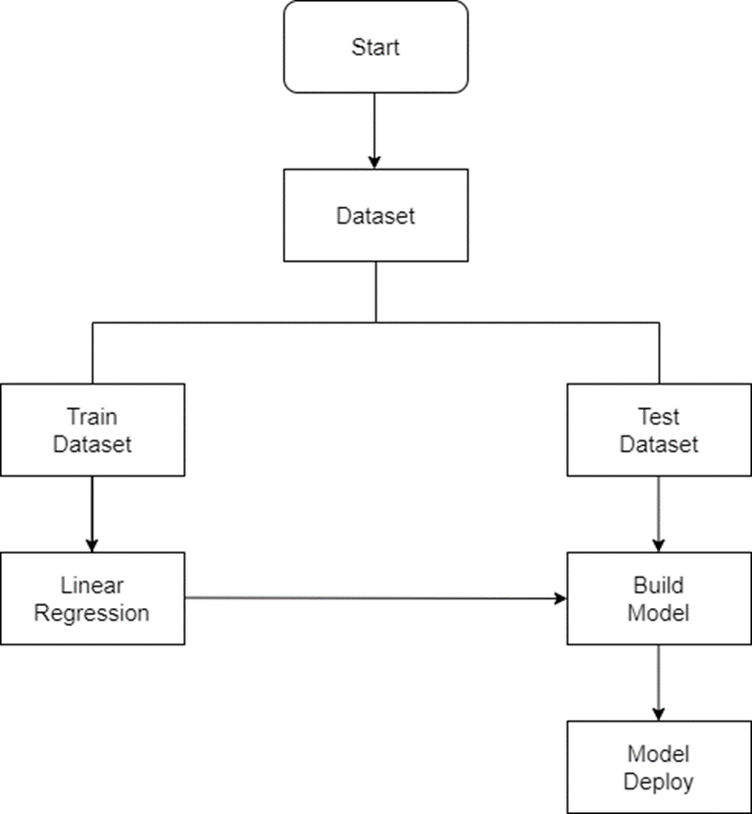
Block diagram(steps):

Slide 20
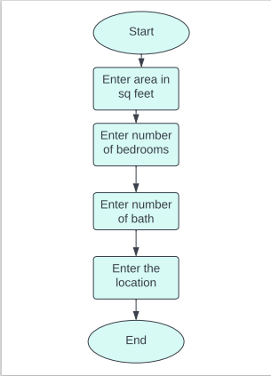
Block diagram(user):

Slide 21
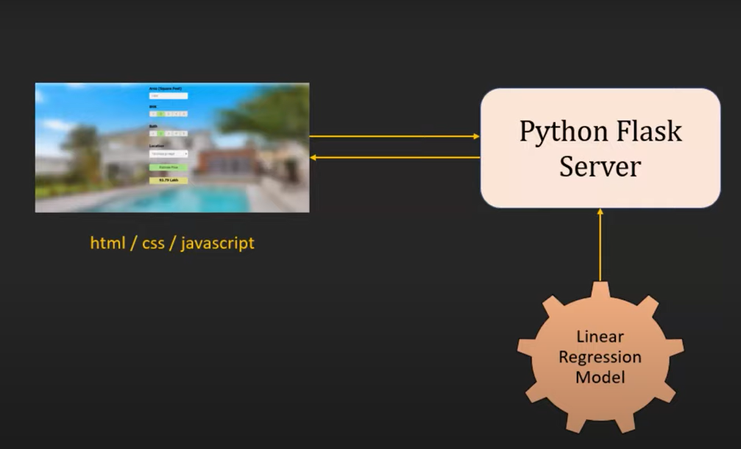
Modules:
There are three modules in this project. They are:
Model building
Writing python flask server
Building website using html, css, javascript

Slide 22
MODEL BUILDING (Description):
Area type, availability, location, size, society, total sq feet, bath, balcony – independent variables
Price(in lakhs)– dependent variable
For supervised learning, you need tagged or labelled dataset where you have input value and output value and based on that, you’re trying to build your model.
The required libraries such as pandas, NumPy, matplotlib etc are imported. The data from the csv file is loaded into a data frame using pandas. There are a lot of different area types.
Features that are not required to build the model such as area type, society, balcony and availability are dropped.
DATA CLEANING:
The number of null values in each attribute is checked.
These null values are because the number of null values is negligible compared to the toral number of values in our dataset

Slide 23
Module Description:
FEATURE ENGINEERING:
New feature (Integer) for bhk (Bedroom Hall Kitchen) is added in dataframe. This is done using the lambda function.
Some total sqfeet is given in range of 100-200 etc. it needs to be changed to one value. To do so, a function called is_float is created. The is_float function is applied to total square feet and the rows which have ranges are identified. This problem is solved by removing the rows that have other units such as 4125Perch, 34.46Sq. Meter etc. For those that have ranges, average of the two values is taken.
New feature called price per square feet is added. In real estate market, price per square feet is very important and this feature will help in performing outlier cleaning(detection and removal) in the later stages.
DIMENSIONALITY REDUCTION:
The number of rows available for each location is checked. Having too many locations can create a problem. So, the total number of locations is identified.
Dimensionality reduction technique is applied here to reduce the number of locations. Having too many locations will result in dimensionality curse.

Slide 24
Module Description:
Any location having less than 10 data points is tagged as the "other" location. In this way, number of categories is reduced by a huge amount. Later, when we one hot encoding is performed, it will help with having fewer dummy columns.
At the end of this step, the number of locations has been reduced from 1287 to 241 which is a lot more manageable.
OUTLIER DETECTION AND REMOVAL:
Outliers are data points which are data errors. They sometimes represent extreme variation in dataset. So, although they are valid, it makes more sense to remove them otherwise they will create more issues later. The techniques applied for outlier detection and removal are: Standard deviation or simple domain knowledge.
Simple domain knowledge: In real estate, when there is a two-bedroom apartment, it cannot be 200 sqft. The average sq feet size of a bedroom is requested from the Domain manager and used as a threshold to determine if the data field is valid. If there is a 600 sq feet home with 6 bedrooms, this is unusual. The domain manager’s feedback is that 300 sq feet per bedroom is the typical threshold. Using this criteria, the dataset is examined and fields where this threshold is not met are removed.

Slide 25
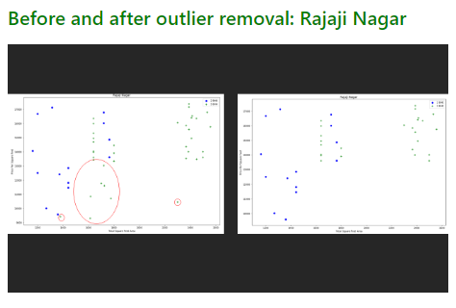
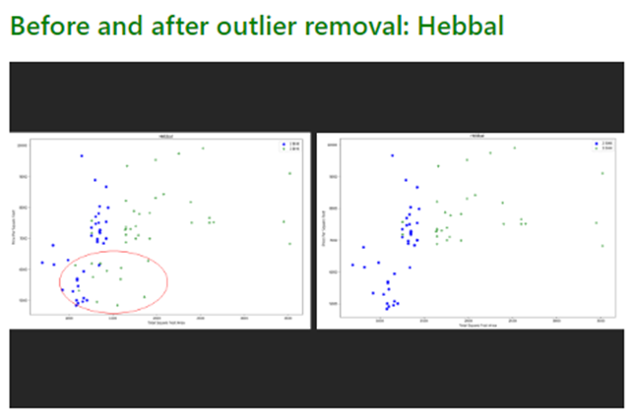
Module Description:
Using standard deviation: If the dataset has a normal distribution which the dataset is assumed to have, then most of the data points(around 68 percent) will lie between mean and one standard deviation. So, anything beyond one standard deviation is filtered out. A function that will remove price per sq feet outliers per location is written.
The function for this calculates the mean, standard deviation and count for each property in each location and then filter out all data points that are beyond this standard deviation (i.e., anything above mean – 1 st and anything below mean + 1 st). In this way, 2000 outliers are removed.

Slide 26
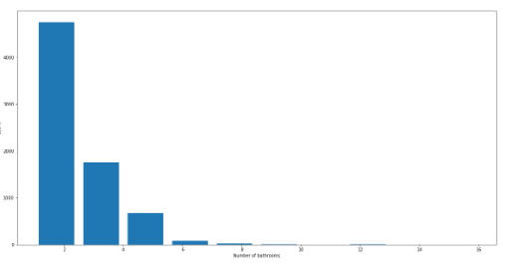
Module Description:
Using number of bathrooms: First, the different number of bathrooms that different properties have is identified. It is unusual to have 2 more bathrooms than number of bedrooms in a home. A histogram is plotted with the number of bathrooms on X axis and the number of properties on Y axis. Most properties have 2 bathrooms.
Next, those properties in which the number of bathrooms is greater than 2 + the number of bedrooms is considered as an outlier and is dropped.
Now the data frame is neat and can be prepared for machine learning training. To do so, some unnecessary features must be dropped. For example, the price per square feet and size can be dropped. This is because price per square feet was created solely for outlier detection. Since that is done, it can be dropped. Next, size is also dropped since bhk exists.

Slide 27
Module Description:
USING ONE HOT ENCODING FOR LOCATION:
Here in this data frame, location column is text data. But machine learning model cannot interpret text data. So, this must be converted into a numeric column. One of the ways of converting text column into numerical information is one hot encoding. It is also called dummies. Pandas dummies method is used here. It works by creating a new column for each location and whichever property is in that location will have value 1 in that column.
To avoid the dummy variable trap, there must be one less column. So, the other column is dropped. To represent that column, 0s in all the other columns. The location column is dropped.
MODEL BUILDING:
A variable X is created containing only independent variables (price is dropped) and variable Y is created containing only dependent variables (price).
The data is now divided into training and testing datasets.
Training dataset is used for the model training and testing dataset is used to evaluate the model performance. Train test split method is imported from sklearn model selection. Test size of 0.2 is taken which means that 20% of samples are taken as test sample and the remaining 80% are taken as model training samples.

Slide 28
Module Description:
USING K FOLD CROSS VALIDATION TO MEASURE ACCURACY OF THE LINEAR REGRESSION MODEL:
A Linear regression model is created. Fit method is called on X train and Y train (which trains X train and Y train) and once the model is trained, the score of the model is evaluated which tells how good it is. Here, 86% is the result.
Typically, a data scientist tries some different models with couple different parameters to come up with the best optimal model. That is what is also done here.
In order to do so, K Fold cross validation technique. Some necessary methods are imported, and a shuffle split is created for cross validation. It will randomize the sample so that each fold will have equal distribution of the data samples.
In the 5 iterations (k value is 5), we get a score above 80% all the time. This is good, but a few other algorithms are tested for regression to determine if an even better score is possible. GridSearchCV is used for this purpose.

Slide 29
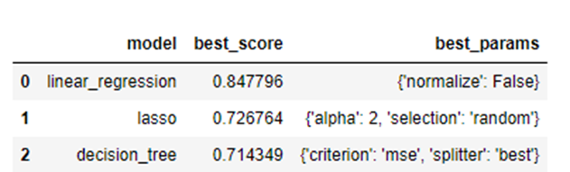
Module Description:
FIND BEST MODEL USING GRIDSEARCHCV:
GridSearchCV is an API that sklearn provides which can run the model on different regressors and different parameters and will tell the base score.
Lasso and decision tree regression are also used in addition to linear regression.
Grid search CV doesn’t just determine the best algorithm selection but also determines the best parameter for that algorithm. This is called hyper parameter tuning.
Cross validation shuffle split will randomly shuffle sample for better result
Based on above results, it can be determined that Linear Regression gives the best score. Hence, Linear Regression is used.

Slide 30
Module Description:
TEST THE MODEL FOR FEW PROPERTIES:
Since linear regression is what has been chosen, the lr clf classifier used above is used to do property price prediction for some samples (to test it) out since it is already trained with 84% score.
A function that takes location, sqft, bath, bhk as input parameters and returns the estimated price is written.
EXPORT THE TESTED MODEL TO A PICKLE FILE:
Pickle file is imported and then pickle.dump is used to which the model is passed with the classifier as an argument.

Slide 31
2. Python Flask Server:
This module involves writing a python flask server which will serve the requests made by the user interface(UI) and predict the price of the homes. It serves as the back end for the UI. It is done using PyCharm.
Saved model(pickle file) and json columns form the artefacts.
Anaconda python 3.9 is used as the interpreter because anaconda comes with flask.
There are two files - server and util.
Util will contain all the core routines whereas server.py is the main server file where flask is imported and will do the routing of requests and response.
Two routines are used. One of them is to return the locations in Bangalore(in the column.json file). Second routine is a function that will return the estimated price given the location, sq foot area, bhk and bath.
Some testing of the http calls of the application is done using postman. First, the get location call is tested and then the predict home price call is tested.

Slide 32
3. Designing User Interface
A website will be built using HTML, CSS and JavaScript.
It allows user to enter home area (in square feet), number of bedrooms, number of bathrooms, location of home and will call python flask server to retrieve the predicted price.
There are three files: app.html (contains the structure of UI of elements), app.css(cascading style sheet which contains the color, look and feel of the webpage and app.js (which will make HTTP calls to the back end and retrieve the data, more of a server communicator.)

Slide 33
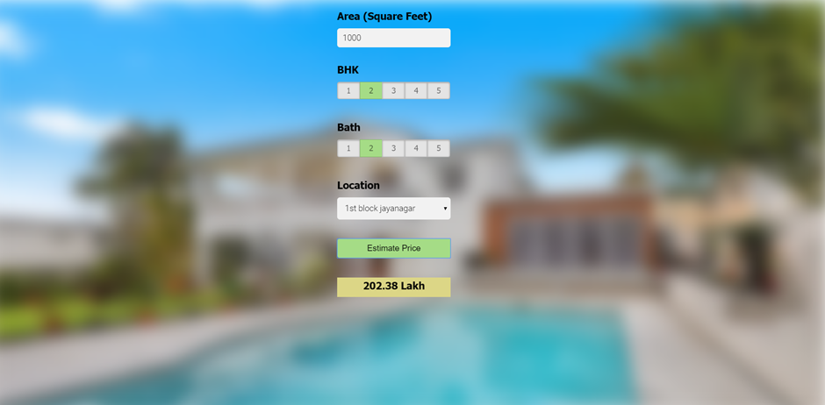
User interface design:

Slide 34
Software and Hardware Requirements:
Technology and tools wise, this project uses:
1.Python
2. Numpy and Pandas for data cleaning
3. Matplotlib for data visualization
4. Sklearn for model building
5. Jupyter notebook, visual studio code and pycharm as IDE
6. Python flask for http server
7. HTML/CSS/Javascript for UI
Hardware used:
Processor – minimum 1ghz

Slide 35

Online course details:
Machine Learning A-Z: Hands-On Python & R In Data Science - UDEMY
S.No | Course Title with Duration | NPTEL/ UDEMY | Status
1. | Machine Learning A-Z: Hands-On Python & R In Data Science | UDEMY Course | Completed
2. | Machine Learning A-Z: Hands-On Python & R In Data Science | UDEMY Course | Completed
3. | Machine Learning A-Z: Hands-On Python & R In Data Science | UDEMY Course | Completed

Slide 36



Slide 37


Slide 38


Slide 40


Slide 41
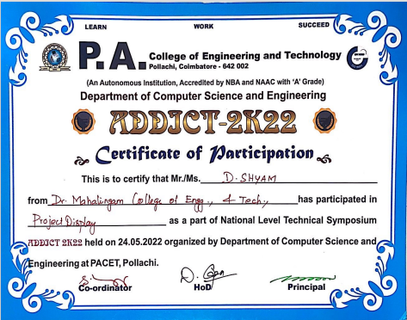

Slide 42


